Slide 1
SPEECH CLASSIFICATION AND EMOTION
RECOGNITION USING ADVANCED MACHINE
LEARNING TECHNIQUES
CS 584 Machine Learning

Slide 2
Team Members
Evelyn Martin (A20495420)
Jasleen Bhatia (A20495939)
Sri Hari Sivashanmugam (A20480978)

Slide 3

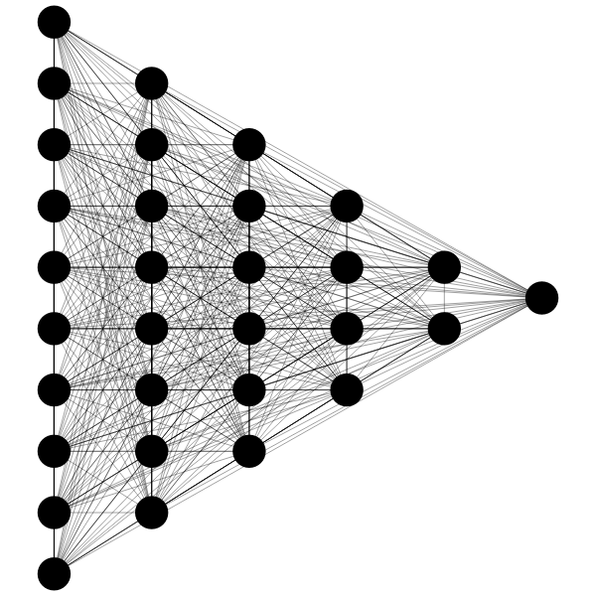

Problem Statement
To build a machine learning model that is capable of taking in a voice as input and to be able to classify it into different classes. These inputs are classified as male and female, and we organize the audio by labeling positive and negative comments by detecting their sentiments through sentiment analysis.

Slide 4
Motivation
Due to covid, people have started to attend virtual psychology sessions. A few among them are unwilling to turn on their cameras, and sometimes it might be difficult for the other person to understand who they are talking to. Using this application, they can detect gender and sentiment of the speaker and to observe them better and make conclusion in an effective manner. We are using a neural network model, to decipher this information using several critical features of an audio.

Slide 5
Implementation

Slide 6
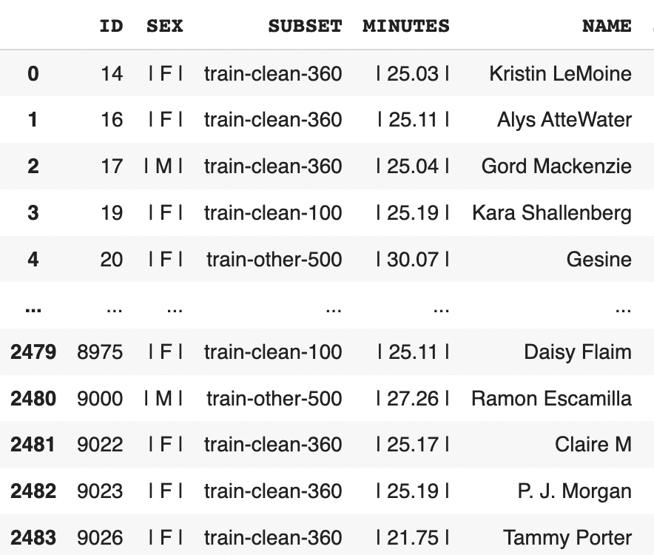
Data
For the purpose of this project we have used the data from Open Speech and Language Resources . This repository has 1000+ hours of recorded english speech.
We have considered the train-clean-100 data, as it is a collection of authors reading their book along with a labelled column of what gender they belong to.

Slide 7
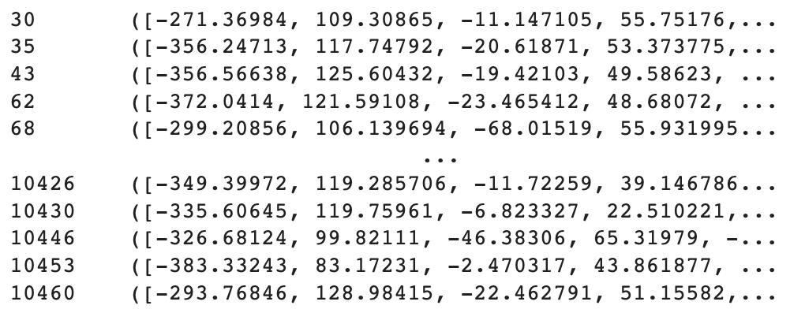
Data Cleaning & Preprocessing
Using the labels we split the audio files into directories based on the gender
For each audio file we extract important information such as mean of MFCCs, mean of chromagram for a fourier transformed audio file, mean of mel spectrogram and some other necessary features
Since, this process takes over ~5 hours for ~10000 audio files, we save this preprocessed array as a pickle file for quick reload when needed

Slide 8
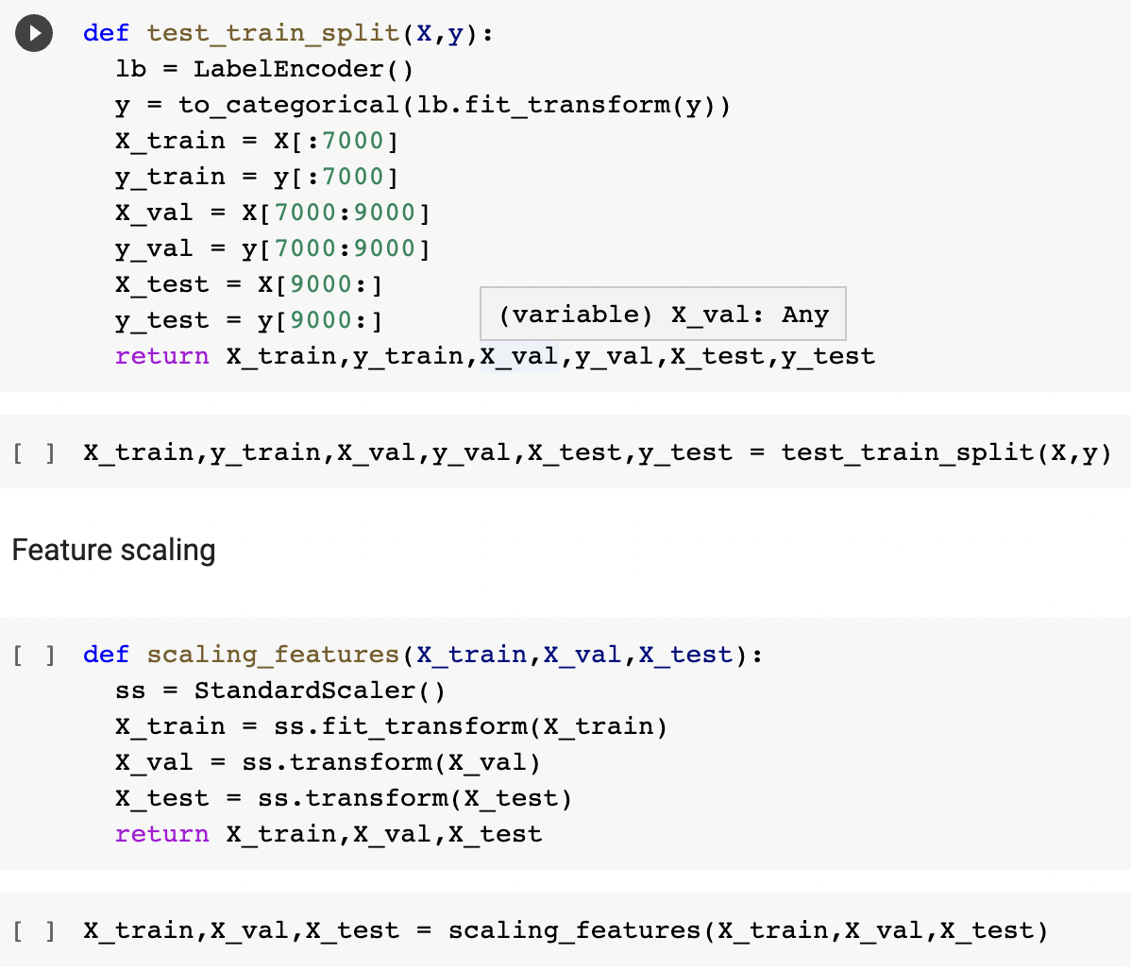
Data Cleaning & Preprocessing
Using the stored pickle file, we load the features and split them into train (70%), validation (15%) and test (15%)
All the predictors are scaled using the standard scalar function
The response variable is one hot encoded

Slide 9
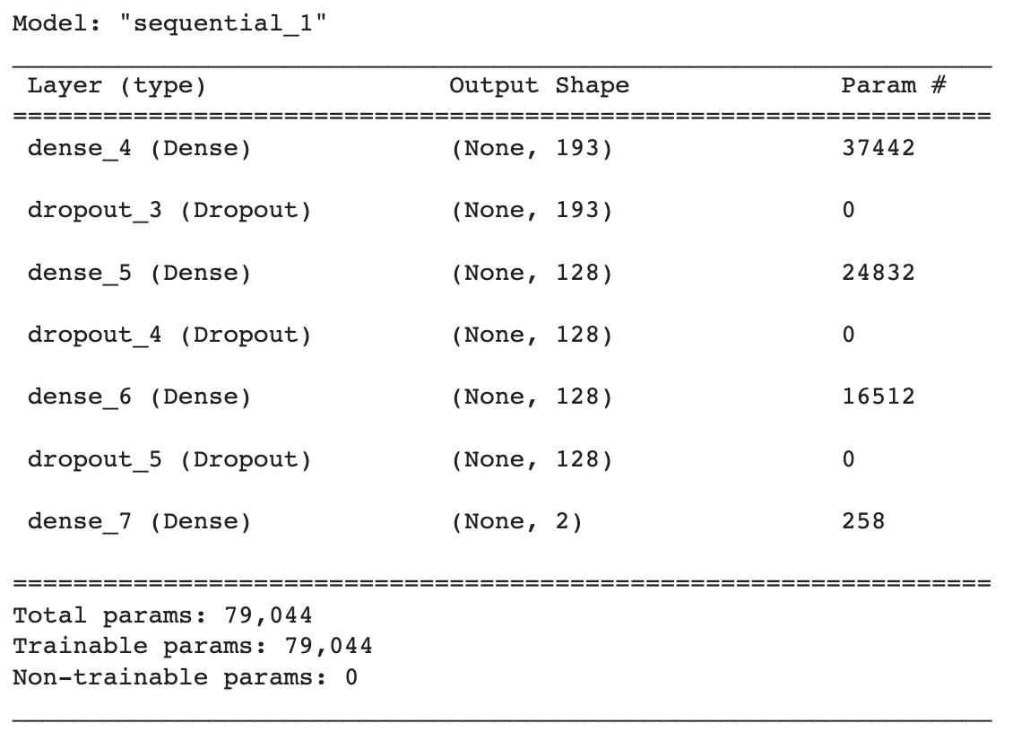
Model Building
An artificial neural network is built with sequential arrangement of layers
The input layer accepts 193 features
The output from the input layer is passed on to a dense layer (3 hidden layers)
There are dropout layers after each dense layer in the NN intentionally to improve the processing speed and time to results
Finally, the output layer has a softmax activation function
The model is compiled using adam optimizer

Slide 10
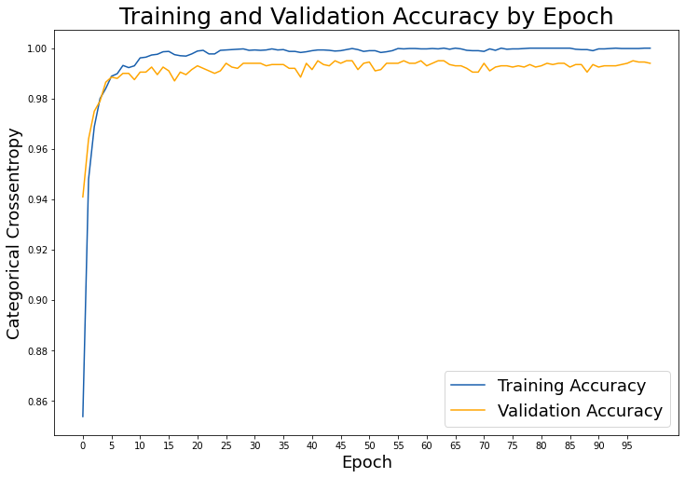
Model Evaluation
During the training phase, we record the training accuracy and validation accuracy for each epoch (totally 100 epochs)

Slide 11
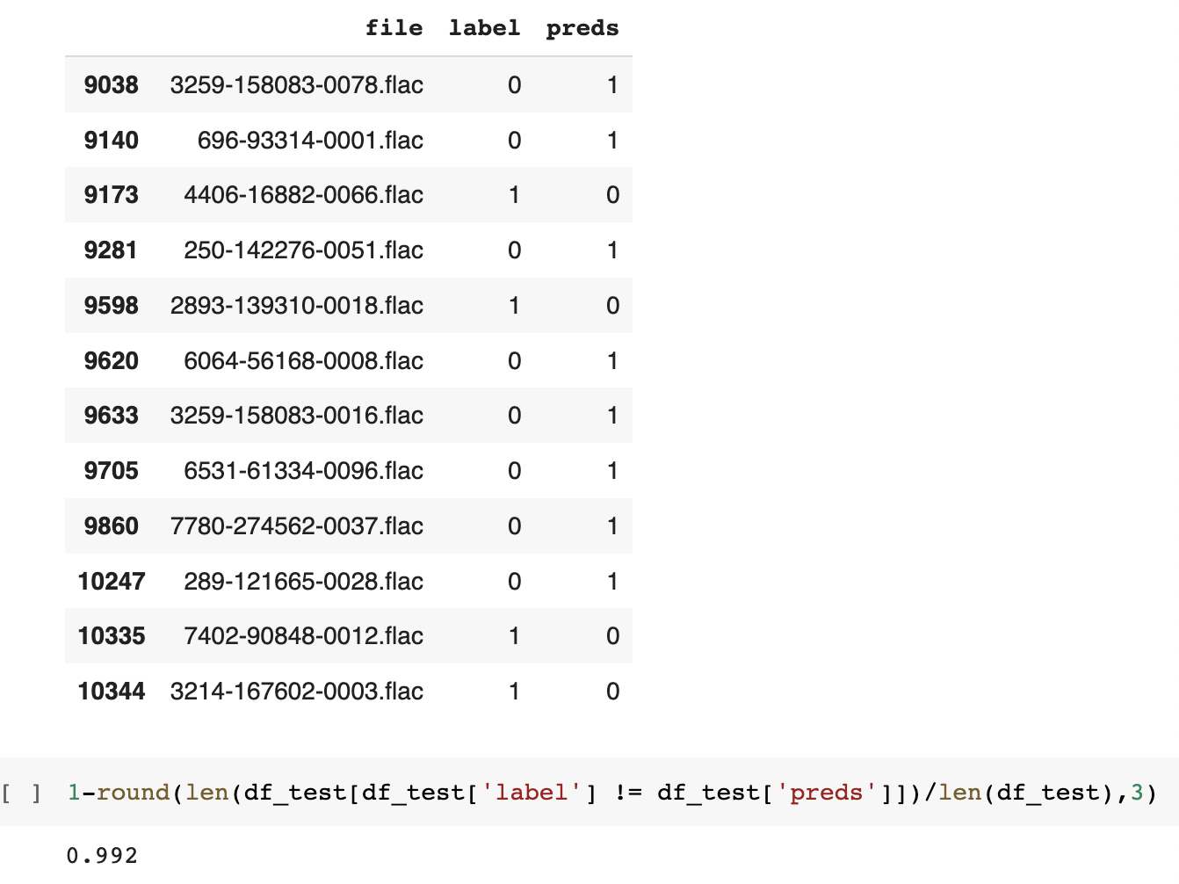
Model Evaluation
We use the test data to predict the gender using the trained model. We observe an test accuracy of 99.2%. Below is an image of the accuracy score and the list of misclassified audio files.

Slide 12
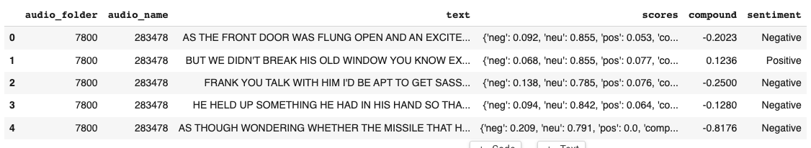
Sentiment Analysis
The text being analyzed from the input audio.
Categorized into two different sentiments - Positive and Negative.
Main goal is to measure the attitude, sentiment, evaluation of the speaker.
Used pretrained model VADER(Valence Aware Dictionary for Sentiment Reasoning).

Slide 13
Conclusion
In the internet age where the information flow has grown rapidly, there is an increase in digital communication especially after the COVID. The listener finds it extremely challenging to comprehend the speaker.
Through this work, we developed a model which will help to detect the the gender of the speaker with the sentiments behind it. The model is implemented using deep learning sequential algorithm which is 99.2 % accurately predicting.
Furthermore, the analyzed input audio measures the attitude and sentiments of the speaker.

Slide 14
Future Work
Currently, our data is not enough to detect the emotions of the the speaker. To do this, we need to manipulate the data by analyzing the speaker pitch, intensity and frequency and creating a model which will capture the correct prediction of speech emotion recognition. We believe this model will give us more clarity regarding the speaker that can explain in real world. The data exploration and analysis so far has given us valuable insights regarding the bottlenecks of computational resources and analysis process.

Slide 15
Lessons Learnt
Using the knowledge gained from this project, we would like to build an improved model with more useful features and try to use new data formats and proper labelling. Moreover, we would like to utilize the docker to streamline the version control, application deployment and portability process , eliminate undesired errors.

Slide 16
Thank You! Any Questions?

